Slide 1
Keynesian model of Income determination
Dr.C.Therasa

Slide 2
Introduction
Adam Smith (1723 – 90), Thomas Malthus (1766-1834), David Ricardo (1772 – 1823), and Jean-Baptist Say (1767 – 1832) were the most prominent classical economists. Their thinking on the macro economic issues ( such as income and unemployment) has mostly been shaped by their time and circumstances of 18th and 19th centuries. But their ideas have also influenced the thinking of subsequent generations.
Their idea of how free market would solve unemployment was widely accepted until the Great Depression of 1930’s. The great depression crippled the free enterprise economies of US and UK with high level of unemployment and glut in the market.
J.M.Keynes (1883 – 1964), after having examined the depression, had revolutionized the macro economic thinking through his writings. His ideas have made greater impact on governments and their role in solving unemployment until recent times. His ideas underlie all modern macro economic theories.

Slide 3
Classical theory of Full Employment
The classical economists believed that the productive capacity of a country decides how much to be produced. An economy produces as much as it can. It assumes the existence of full employment. It has not thought of unemployment of any factor of production, particularly labour. The confidence that market makes it possible to sell everything that is produced is based upon Say’s law.
Say’s Law of market is a denial of the possibility of general over-production or mass unemployment deficiency of aggregate demand in a free economy.
J.B.Say, a French economist, propounded his law of markets in his book, “Treatise on Political Economy” (1803). His law can be summarized as “supply creates its own demand”. This means that production of every good generates sufficient income to ensure that there is enough demand for the goods produced.

Slide 4
Classical theory of Full Employment
Every production which brings goods to market does so only in order to exchange them for other goods. It precisely states that whatever be the level of output and the income created by that will necessarily lead to an equal amount of spending and hence deficiency of aggregate demand cannot occur.
Hence, Say rejected the view that there could be general over-production, and mass unemployment. Only full employment prevails in the economy. He made the following assumptions
1. All incomes of the households are spent on consumption of goods and services.
2. There is no government activity (no taxation, public spending, price control ect.
3. It is a closed economy i.e no relationship with other economies.

Slide 5
Classical theory of Full Employment
Whatever is produced represents the demand for another product. Additional supply is additional demand. Thus Say’s analysis is carried on in terms of barter. However, introduction of money no way affects the process. In fact, money-based economy is more efficient than barter economy. It is true that sometimes, misdirected production may result in temporary over-supply of a particular product in a particular industry. Say himself admits this fact. But this disequilibrium disappears by the operation of the self-adjusting market forces. But general over-production or unemployment is impossible according to Say.
The essential aspects of Say’s law can be summarized as:
Economy is self adjusting
No general over-production or unemployment is possible
All idle resources are fully employed
There is economic interdependence between nations
Flexible wage rates prevail in the economy
Money is simply a veil
It helps international trade and
No government interference is essential

Slide 6
Criticism of Say’s Law
Keynes has clearly exposed the weakness of Say’s law. In 1936, Keynes brought about a revolution in economic theory attacking Say’s law. In 1930’s, Great Depression and its effects showed that the classical theory of employment was wrong and its foundation was unacceptable. The criticisms are as follows:
Great Depression made Say’s law unpopular
All incomes earned are not always spent on consumption
Similarly, whatever is saved is not automatically invested
The law was based on wrong analysis of market
It suffers from the fallacy of aggregation
Aggregate supply and aggregate demand are not always equal
Rate of interest is not the equilibrating factor
Capitalist system is not self-adjusting always
Perfect competition is an unrealistic assumption
Money is a dominant force in the economy
The law is applicable only for long period
Say’s law holds good only in a barter economy

Slide 7
Criticism
Say’ law has no validity and use now.
However, the classical theory relied on Say’s law to assure that there would always be full-employment as a result of equality between aggregate demand and aggregate supply. In short, there cannot be deficiency of aggregate demand. Even if there is any unemployment, the market mechanism would restore full employment.

Slide 8
Keynesian theory of Income determination
Keynes is considered to be the greatest economist of the 20th century. He wrote several books. However, his ‘The General Theory of Employment, Interest and Money’ (1936) won him everlasting fame in economics. The book revolutionized macro economic thought. Keynesian economics is called the Keynesian revolution.
The central problem in macroeconomics is the determination of income and employment of a nation as a whole. That is why modern economists also call macro economics as the theory of income determination. Keynes brings out all the important aspects of income and employment determination and Keynesian economics itself is called as macro economics. He attacked the classical economics and effectively rejected the Say’s law. He believed that in the short run, the level of income of an economy depends on the level of employment. The higher the level of employment, higher will be the level of income.
Total income depends on total employment which depends on effective demand which in turn depends on consumption expenditure and investment expenditure.
Consumption depends on income and propensity to consume. Investment depends upon the marginal efficiency of capital and the rate of interest.

Slide 9
Principle of Effective demand
It occupies a key position in the Keynesian theory of unemployment.
Effective demand is the ability and willingness to spend by individuals, firms and government. The level of output produced and the level of employment depends on the level of total spending in the economy.
Keynes used ‘aggregate demand and aggregate supply approach’ to explain his simple theory of income determination. The term ‘aggregate’ is grand total of all goods and aggregate demand (ADF) is the total demand for all commodities (goods and services). Aggregate supply (ASF) is the total of commodities supplied in the economy.
Keynes made it clear that the level of employment depends on aggregate demand and aggregate supply. The equilibrium level of income or output depends on the relationship between the aggregate demand curve and aggregate supply curve.
As Keynes was interested in the immediate problems of the short run, he ignored the aggregate supply function and focused on aggregate demand. And he attributed unemployment to deficiency in aggregate demand.

Slide 10
Principle of Effective demand
It is important to note that all demand is not effective. According to Keynes, effective demand if that point where ADF and ASF are equal. ASF represents cost and ADF represents receipts. Cost must not exceed receipt. When the entrepreneurs find that their receipts are less than their costs, they will stop offering employment to new workers. So long as their receipts are higher than the costs, they will increase employment as they can increase their profits by offering more and more employment.
The point of intersection between the two curves shows the maximum possible employment. According to Keynes, the level of employment depends on total demand and unemployment results as a consequence of a fall in total demand. If unemployment is to be averted, the remedy lies in increasing the effective demand.

Slide 11
Aggregate demand
The total expenditure of an economy can be divided into four categories of spending. They are consumption expenditure (C), investment expenditure (I), government expenditure (G) and net expenditure on trade or net exports that is exports – imports (X – M). The aggregate demand is the sum total of all such spending. Hence it is represented as
AD = C + I + G + (X- M) ------------ eq (1)
It is the amount of commodities people want to buy. In the economy, as one man’s expenditure is another man’s income. The total expenditure must be equivalent to the total income. That is income (Y) = Total expenditure (AD). Since Y = AD, eq (1) can be written as,
Y = AD = C + I + G + (X-M) ---------------eq (2)
Assuming that ASF is constant, the main basis of Keynesian theory is that employment depends on aggregate demand which itself depends on two factors.
Propensity to Consume ( Consumption function)
Inducement to invest (Investment function)

Slide 12
Consumption function
People spend most of their income on commodities. Some spend their income fully and some others spend a portion and keep the rest for saving.
How much the community as a whole spends and saves? It is about the relationship between income and consumption
The term ‘consumption function’ explains the relationship between income and consumption. A function is the link between two or more variables. The proportion of income spent on actual consumption at different levels of income is called propensity of income.
There is a direct relation between income and consumption. Consumption function or propensity to consume is the ratio that measures the functional relationship between income and consumption. In mathematical form the relation can be expressed as,
C = a + bY (Consumption depends on income)

Slide 13
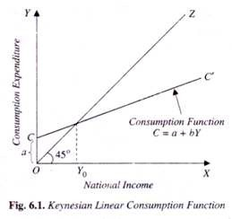
Consumption function
Thus consumption function is a linear equation Y = a + by where the constant ‘a’ is the amount of autonomous consumption and Slope b is MPC. The rate of change in consumption due to change in income depends on the MPC.
The equation simply states that Consumption (c) depends on income Y.
The + sign indicates that as income increases, obviously consumption will also
Increase. But the rate of increase in consumption will be little less than that
of the rate of increase in income. It is because some unspent portion of the
income will be saved. Hence Keynes aspect in law of consumption states that
“the psychology of the community is such that when real income is increased,
aggregate consumption is increased, but not so much as income”.
Keynes also made it clear that in the short run, the consumption function is
stable.
For eg, C= 4 + 0.8 Y
The consumption curve CC’ is a short run curve. In this case, consumption
takes place even when income is zero. In Eg, 4 is the level of initial
consumption when income is 0 and it is not affected by income.
Even when income is zero, people spend some minimum level either
by gift or borrowing. This consumption which is not related to income is called
as autonomous consumption.

Slide 14
In eg, 0.8 indicates that 80 percent of additional income is spent on consumption and it is called as marginal propensity to consume (MPC). Thus MPC is the ratio of change in consumption to change in income. In other words, MPC is the rate of change in propensity to consume.
MPC = Change in consumption
Change in income
The propensity to consume is assumed to be stable in the short run. Therefore out of the given income how much will be spent depends on the slope of the curve. In our example, 0.8 indicates that out of every additional income earned, 80% will be spent for consumption keeping the rest for saving. In short, consumption function relates the amount of consumption to the level of income. Thus consumption of an economy depends upon the level of income. When the income of an economy rises, consumption also rises and vice-versa. Suppose people spend more in an economy in relation to their income, their MPC will be more.
=
C
Y

Slide 15
Keynesian law of consumption implies the following three aspects:
1. Increase in income and increase in consumption are not at the same proportion. Consumption function is positive but less than one.
2. An increase in income is share between consumption and saving
3. Increase in income will not cause rise in consumption and saving at the same time. If the rate of increase in saving rises, the rate of increase in consumption will fall.

Slide 16
Saving function
The portion of the income not spent on consumption is saving. Saving is consumption forgone. If saving rises, consumption will fall. According to Keynes, the level of saving in the economy, like consumption, depends basically on income. The relationship between saving and income can mathematically be expressed as in eq . 3 and that is called as saving function.
S = -a + by
S = -4 +.2 Y ….. Eq:3 Where S-Saving, Y – Income, -a = dis-saving
Marginal Propensity to Save (MPS) is the ratio of change in saving to a change in income. Thus it is the rate of change in the propensity too change.
MPS =
With an increase in income, if MPC tends to fall, MPS will tend to rise. If, MPC remains constant, MPS also will remain constant. Thus income consists of consumption and saving.
Hence Y = C + S or MPC + MPS =1; MPS = 1-MPC; MPC = 1-MPS
S
Y

Slide 17
In an economy, where people spend less of their additional income, MPC will be less and the CC curve will be less steep. Note that the constant (-a) is dis-saving because it is autonomous consumption which is unrelated to income. The autonomous consumption will became zero in the long run. That is, households cannot consume without income in the long run. Hence in the long run, the consumption purely depends upon income and the curve C starts from origin.
Other determinants of consumption
Income distribution
Size and nature of wealth distribution
Age distribution of population
Inflation or price level
Government policies
Rate of interest
Expectations about price, income etc.
Advertisements
Improvement in the living standard
Changes in cultural values

Slide 18
Investment function
In economics, investment function means additions to the existing productive capacities ( stock of fixed capital and inventories). They include fixed equipments, machinery, building, raw materials, replacement due to depreciation etc. It lays down the basis for future production. Investment is the key structural component of total spending or aggregate spending.
By investment, Keynes means real investment and not financial investment. Investment is the addition to real capital assets. It does not mean the purchase of bonds or shares which are financial investment. The distinction between consumption and investment is fundamental in Keynesian theory.
Consumption is a stable function of income. So it is not possible to change aggregate demand by changing consumption expenditure as it depends on income. Keynes found that investment is an autonomous expenditure determined independently of the level of income. He found it to be the major cause for the variation and instability in income and employment. The worldwide depression of 1930’s was also caused by fall in investment.

Slide 19
Determinants of Investment
According to Keynes, employment depends on investment. Employment fluctuates on account of fluctuations in investment. Therefore, we must discuss what determines the amount of investment. Investment spending is determined by
Expectations of future profitability or business confidence
Rate of interest
Firms invest either from their own profits or by borrowing. Household having saving, have to decide whether to invest the money for profit or lend/ deposit for interest. If the expected profits is higher than the rate of interest, then the households will invest. Otherwise they will lend or deposit their oney for interest. Firms who invest their own profit will also decide in the same manner. Suppose the firms borrow for investment, then they have to pay interest for that. Hence, firms will invest borrowed money only when the expected profit is high enough to pay the interest and the cost of initial capital.

Slide 20
Thus in all the cases, the decision to invest will be based on the rate of interest and business confidence. Of these two, business confidence or expectations about future profitability has got higher significance than the rate of interest. This is because rate of interest is stable in the short run. The expectations about profitability involves several considerations of the future about which there cannot be any certainty. Bleak prospects will lead to a reduction of investment and it will not affect employment and vice versa.
Savings and investment are the basic economic activities of an economy. But aggregate savings and investment will not always in equilibrium. Classical economists believed that savings were automatically invested. They thought decisions to save and invest were made by same persons. But Keynes argued that the decisions were made by different persons and were influenced by different factors. Thus sometimes, savings might exceed investment. At this situation, there would be deficiency of aggregate demand and general employment.
Keynes thought the gap between S and I could be filled by government intervention either directly by increasing government expenditure or indirectly by actions influencing the supply of money.
Thus, s= I
Therefore, Y = C + I; or Y = C + S

Slide 21
Simple Income determination
According to Keynes, the level of income of a country in the short run will change as a result of change in employment. The level of employment depends on aggregate demand and aggregate supply. The equilibrium level of income depends on the balance between aggregate demand and aggregate supply. Full employment prevails when there is equality between these two. Thus the model can be used to show the determination of income, output and employment.
Assumptions
1. there are only two sectors. Consumers (c) and firms (I)
2. Government influence on the economy is nil. In other words, government expenditure (g) is zero. As there is no taxation, all personal income will become disposable income.
3. The economy is a closed one without any influence of foreign trade (X-M)that is X-M = 0.
4. Wages and prices remain constant
5. there are unemployed resources and hence less than full employment equilibrium
There is no variation in the rate of interest
Investment is autonomous and it occurs due to change in social welfare programmes and it has no effect on price level or rate of interest
The consumption expenditure is stable.

Slide 22
Due to the first three assumptions the basic equation
Y = C + I + G + X – M
has been reduced to Y = C + I
Vertical axis measures total or aggregate demand or aggregate expenditure. Horizontal axis measures income and output.
Aggregate supply is the total value of all commodities that the firms intend to supply(produce). This purely depends on available technology, resources (material and human), efficiency of labor etc. Most of these factors change only in the long run and remain constant in the short run. AS the aggregate supply curve represents equality of total income and output , the 45 degree line is drawn from the origin representing AS curve. It divides the quadrant into two equal halves with equal distance from the two axes. Every point on the line indicates equal amount of income, output, and expenditure ( Y=E). The importance of this is that if any other line intersects the 45-degree line, the point of intersection will show an equal amount of income, output and expenditure.

Slide 23
Aggregate demand represents the total expenditure on consumption and investment (or total expenditure). The aggregate demand (expenditure) curve is the combination of consumption and investment function. C represents consumption function. When investment is added, it becomes C+I. the value of investment is shown by the vertical distance between C and C+I curves.
Thus Aggregate Expenditure (AD) = C+I
Equilibrium occurs at the point of intersection of aggregate demand and aggregate supply. At point E, the planned total spending (or aggregate demand) by consumers © and investors (I) is equal to the total amount of national income (Y = C + I). The equilibrium level of output also determines the equilibrium level of employment. Hence, at point E, we get equilibrium level of income, output and employment.
The equilibrium level of employment need not correspond to full employment. If any of the components of aggregate demand rises at each level of income, for example because government increases its expenditure, that shifts the entire AD line upward. This raises equilibrium income and output. Similarly, if any one component of AD falls, that shifts the line downward and lowers equilibrium output.

Slide 24
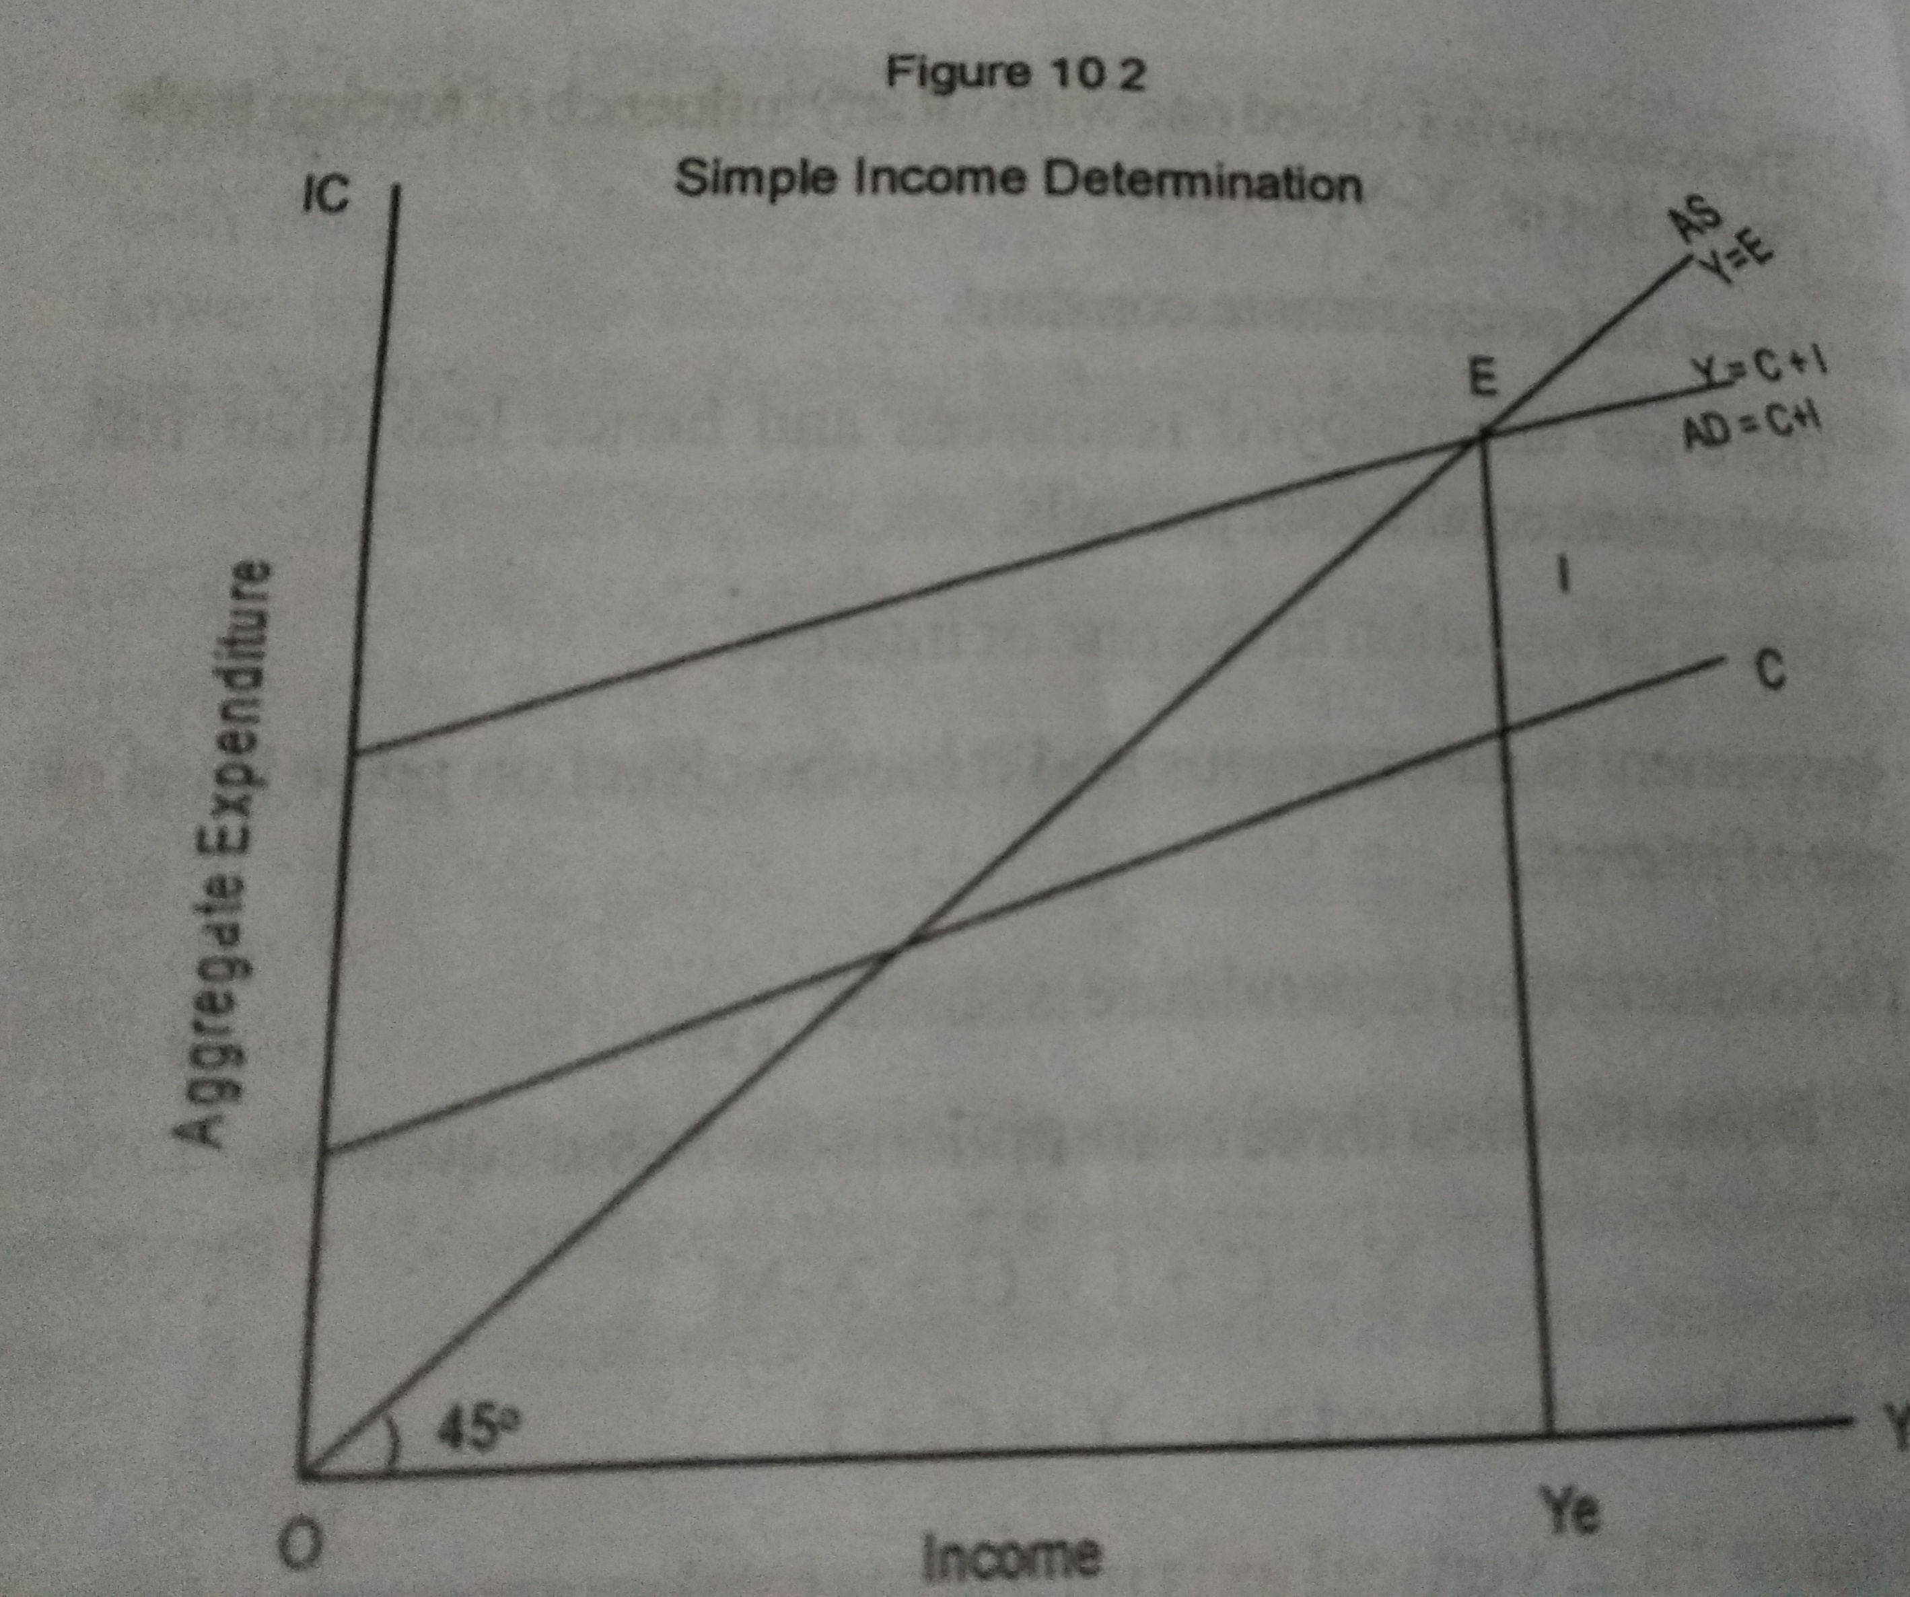

Slide 25
Multiplier: Ultimate determinant of Income and Employment
The ultimate determinant of income and employment is the multiplier. Any increase in investment increases income manifold due to multiplier effect. Thus the concept of multiplier expresses the relationship between an initial investment and the final increment in the GNP. That is, the magnified or amplified effect of initial investment on income is called as the multiplier effect. It is measured by the ratio of change in equilibrium income to change in expenditure.
Multiplier (k) = change in equilibrium income/change in expenditure
K = delta Y (increase in national income) /delta I (increase in investment)
K is the co-efficient that shows the number of times at which income increased due to increase in investment. K is also calculated by another way,
K = 1/MPS or K = 1/1-MPC
For eg, if investment increases by 500 crores in an economy and if MPS is 25%, the increase in national income is calculated by,
K = change in income/ change in investment = 1/MPS
= change in income/500 = 1/0.25
= change in income/500 = 4
= change in income = 4(500) = 2000, Hence, National income increases by 2000 crores

Slide 26
Government spending
Simple income determination has used only two kinds of expenditure. One is consumption expenditure (c) to produce consumer goods. Second is investment expenditure (I) to produce capital goods. The third component is the public expenditure (G) made by Government. It is made to produce public goods like literacy, public health, child nutrition, social welfare and many more for the collective well-being of the society.
Classical economists held the view that government was unproductive and Keynes rejected their idea and argued that government activities (taxing and spending) strongly influence the level of economy. Taxation and public spending can be used to achieve macro goals like growth and economic stability. This usage is called fiscal policy.
Keynes proved that fiscal policy is more effective in recovering economies from depression. Public expenditure can be used to increase effective demand during depression. The injection of money in the economy will generate demand and this will increase investment and employment. Thus public expenditure will put back economy on its growth path.
Many countries adopted his policy suggestions and recovered from Great Depression of 1930’s. since then role of government and fiscal policy became important in macroeconomic management.

Slide 27
Principle of Acceleration
According to the theory of multiplier, the increase in investment generate manifold increase in income. Such increases in income increases consumption. The initial increase in demand automatically gathers momentum. The available productive capacities will be exhausted fully. This in turn encourages more investment to meet the expanding demand.
As the existing productive capacity would not be enough to meet the expanding demand, productive capacities will be expanded by new investments.
Thus the level of investment depends upon the rate of change in income and the resultant change in consumption. This is what called as the principle of accelerator. According to this principle, net investment is positively related to changes in income.
The theory of multiplier states the effect of investment upon the level of income. The principle of accelerator states that the effect of an increase in income upon the level of investment.

Slide 28
Money and Interest
Keynes represented a monetary theory of interest. It is known as the liquidity preference theory of interest. Interest, according to Keynes, is payment for the use of money. The demand for money (liquidity preference( and the supply of money, determine the rate of interest. The essence of the Keynesian theory of liquidity preference is that the quantity of money, along with the state of liquidity preference determines the rate of interest.
Keynes made it clear that interest is not the reward for savings as assumed by the classical writers. The rate of interest is the “reward for parting with liquidity for a period”. In other words, the rate of interest is largely determined by the attitude of the people to part with liquidity if their liquidity preference is strong.

